Slide 1
Cornell Information Chatbot
Xintian Gu, Wanming Hu,
Xiaoxian Lin, Xinye Liu,
Yue Sun, Yingkai Tan,
Bill Tang, Zhonghao Zhan

Slide 2
Client
Marty J. Sullivan
DevOps / Cloud Engineer, IT@Cornell

Slide 3
Agenda
Goal
Tool/Environment
Demo
Front-end
Back-end
Security/Sync
User Testing
Gap/Weakness
Future
Q & A

Slide 4
Goal
An interactive chatbot on mobile application to answer Cornell Orientation and other questions.
Users send questions in text or audio
Questions include weather, food, health, study, etc.
To help first-year Cornell students adapt their college life more quickly and smoothly.

Slide 5
Goal
For this milestone...
Improve UI & User Experience
Solve synchronization & security issues
Reduce hard code from back-end
Implement User Testing

Slide 6
Tool/Environment
AWS Service:
Cloudformation, API Gateway, Lambda function, DynamoDB
Language:
Swift, Python
Version Control:
BitBucket

Slide 7
Demo

Slide 8

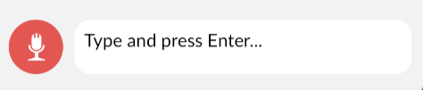
Frontend / Accomplishments
Fixed known bugs + UI improvements
Auto-scrolling, keyboard return
button arrangements.
Added instruction page
Added map functionalities
Google > Apple > Safari
Checked deployment issues
Works for all iPhones

Slide 9

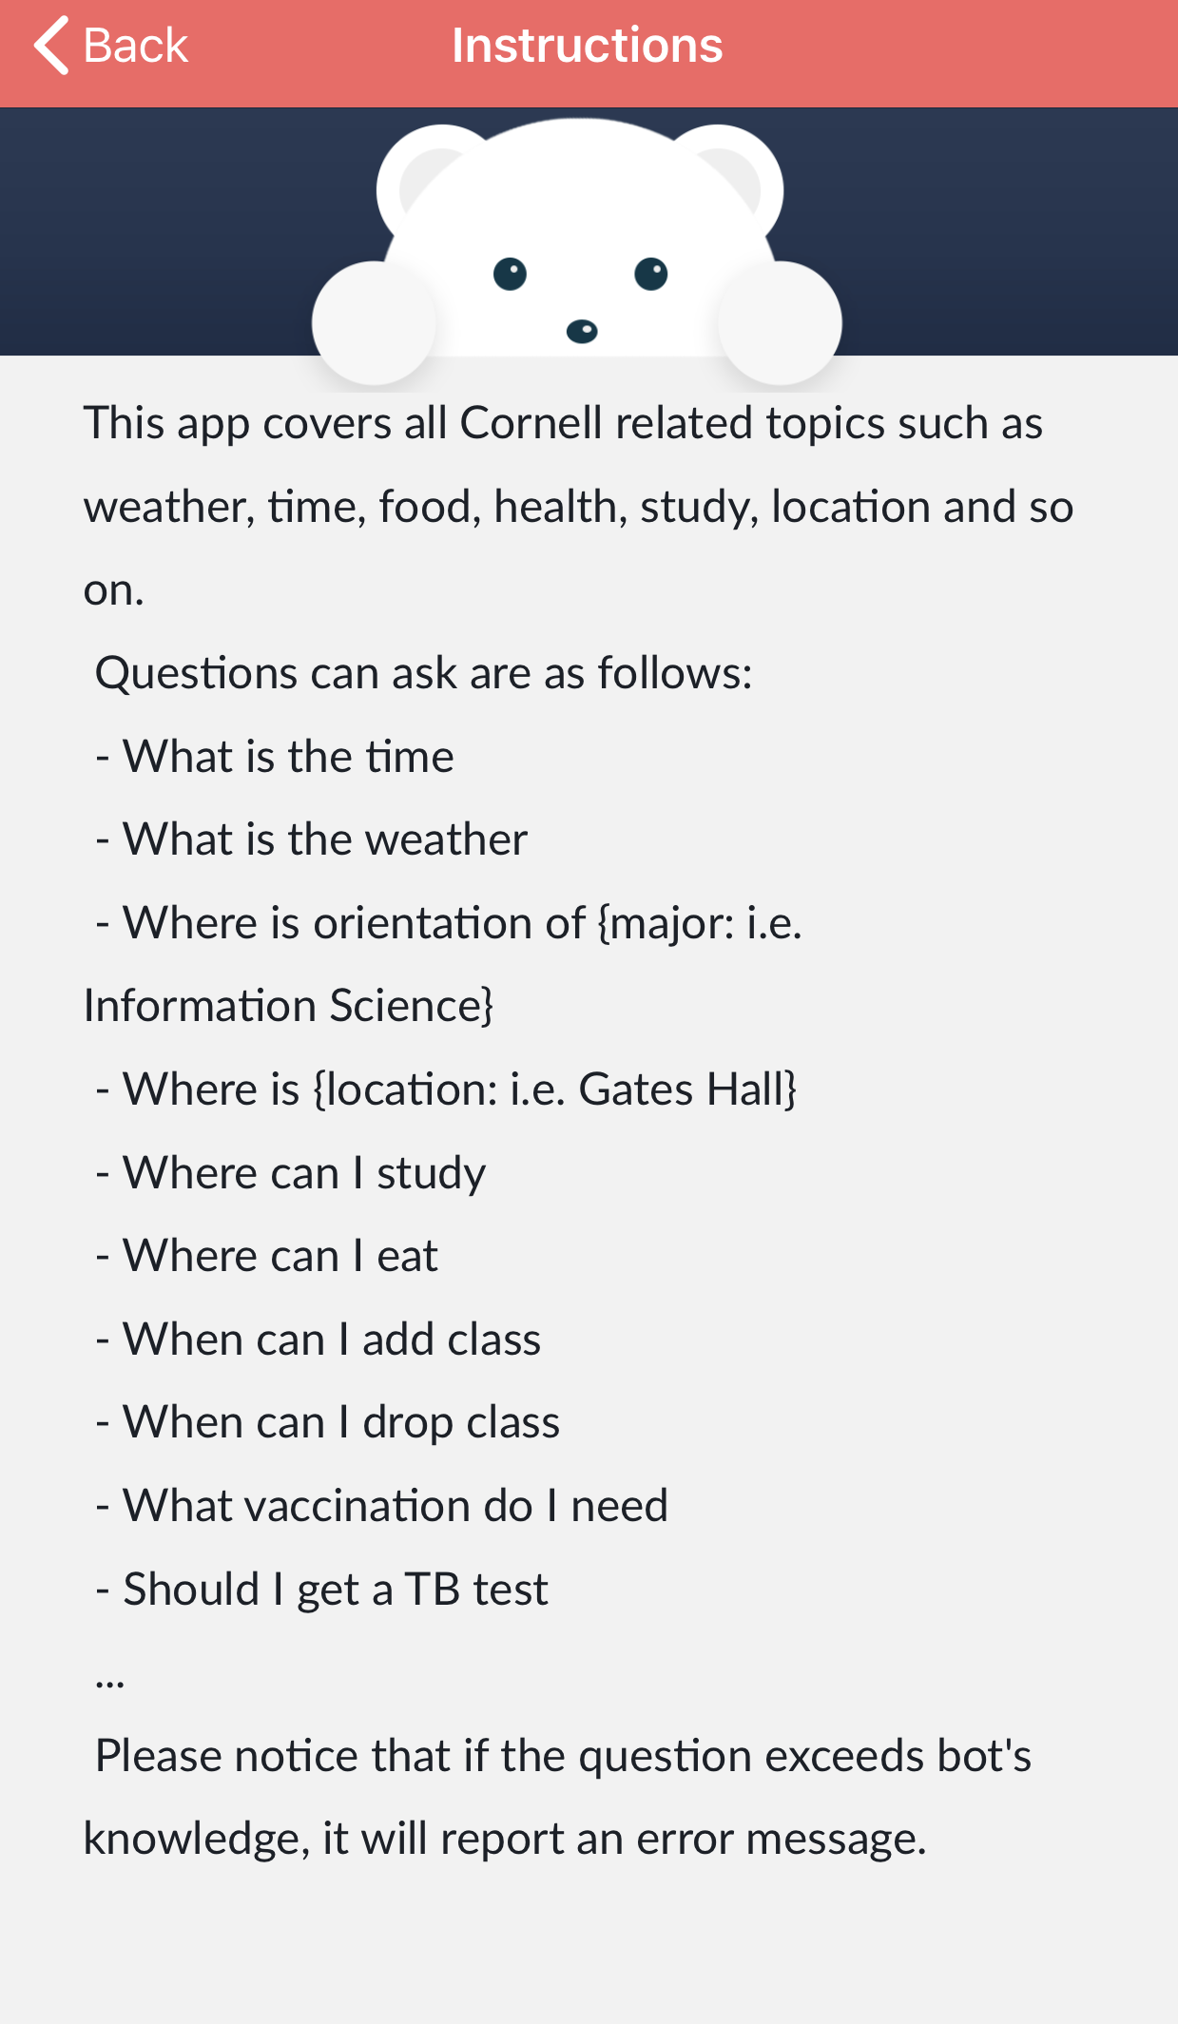

Slide 10
Frontend / Risk
Time constraints post user testing
Might have previously unknown bugs that we need to work on.
Improvements can certainly be made but might not be able to accomplish all due to tight time constraints.

Slide 11
Frontend & Design / Add-on
Further improve UI and UX based on feedbacks from user testing.

Slide 12
Security
Security Protocol:
Initial Connecting Stage:
Client machine ID → API
API(User machine ID) = API KEY
Add the API KEY to a Usage Plan
Client ← API KEY
Communicating Stage:
Client request + API KEY → API Access

Slide 13
Synchronization
The unique client device ID is used to differentiate various clients, requesting
the same service / resource
at the same time

Slide 14
Backend / Accomplishments
Reduce hard code
Test/Fix/Improve current lambda functions
Improve logic between lambda functions
Facade
Add more Orientation Information

Slide 15
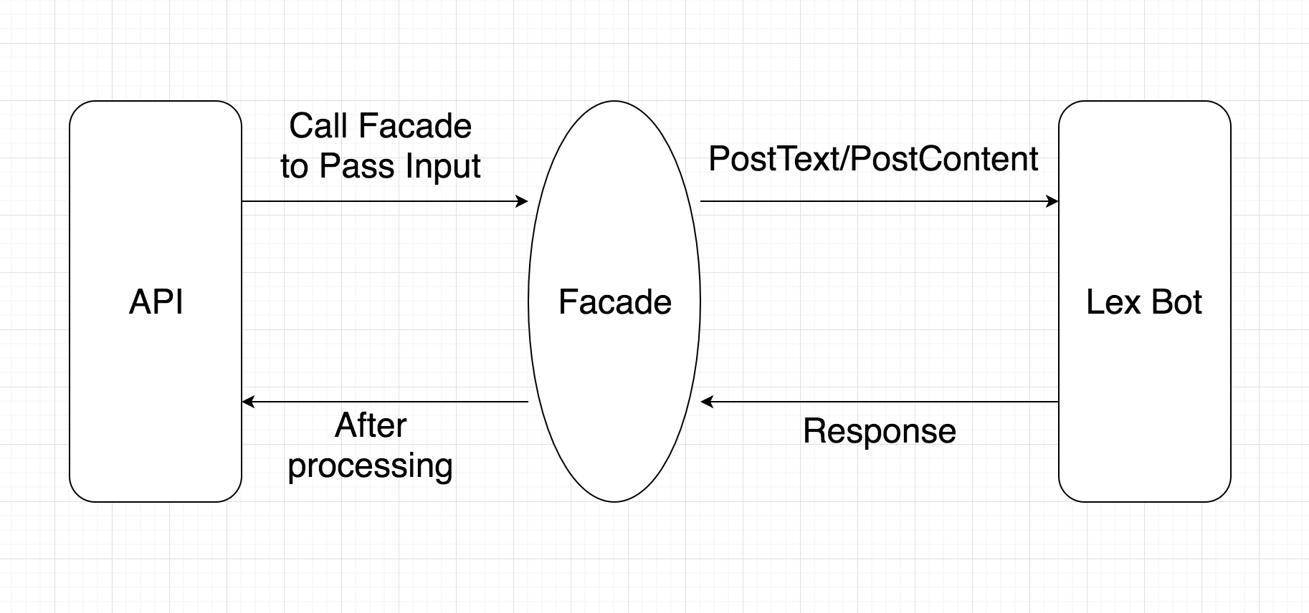
Backend / Accomplishments
Facade
Notes:
An encapsulating module that reduces coupling between our API and our Lex bot.
A pre-processing system that analyzes Lex responses and provides answers more effectively.
Example application:
Previously, the bot will have to ask for a location when asked ”What’s the weather outside”
Now, the facade will help answer with default location “Ithaca” if no explicit location is provided

Slide 16
Backend / Risk
Limited answer pool
More hard code
Maintenance and code readability in the future has potential pitfalls

Slide 17
Backend / Add-on
Keep expanding Q&A topics covered
Handle more errors in “Facade”

Slide 18
User Testing - Process
Goal: To test the effectiveness of the app and users’ satisfaction with the interaction.
Test 10 users
Due to a limit of questions, users are given instructions and tasks to complete
Take notes and do screen-recordings during the process
Ask additional questions after finish testing

Slide 19
User Testing - Metrics
Metrics | How to Measure | Result | Reason
Effectiveness | Ability to complete a task | Low | Users have to follow a sentence pattern to ask questions
Efficiency | Time and number of clicks to complete a task | High | User are able to type in a question and get answers
Learnability | Ability and time to complete a task for the first time | Medium | User barely notice the instruction page and make use of it, but are able to complete task on their own.

Slide 20
User Testing - Feedback
More question to ask in the future
Dorm
Parking
Bus Route
Operation Hours
Student event
Weather for tomorrow

Slide 21
Gap/Weakness
The final polishment of the application requires the front-end team and the back-end team closely work together
The gap will be created when members don’t have good communication because of other works and final reviews
Notes:
Gap: The miscommunication between the backend team, frontend team and clients would be a problem. During the final stage of project, when we are wrapping up this project. The backend errors would not directly indicated at frontend without unit testing. Some potential backend problems might not be solved yet.
Weakness: User testing: we do not have enough time to modified or refine the relevant problematic features, including utterance and linguistic problems.

Slide 22
Future
Document User and Developer Guide
Deploy on different platforms such as Android, Web or social media extensions.
Reach out to the team which will take over the development and maintenance in the future

Slide 23
Q&A
Any Questions?

